Slide 1
Clean Coding
Estimating Time:
8 Hours

Slide 2
Key Points
Name Conventions
Functions
Code Structure
Error Handling
Classes and Data Structure

Slide 3
Intro
What is Clean Code?
Clean Code <--------> Patterns and Principles
(what?) (how?)
Clean Code <--------> Clean Archtecture
(what?) (where?)
Notes:
That is clean code?
Readable and easy to follow code.

Slide 4
Solutions
Following Pattern and Principles

Slide 5
Workshop Preview
How would it work?
  We’ll start with a problem
  Understand why is it a problem?
  Understand the concepts we should follow
Demos and Examples
  Bad and Good Code in action
  Bad Code ---> Good Code transformation
Drills

Slide 6
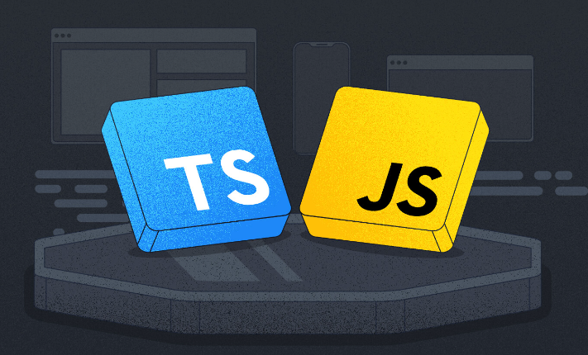
Tools Used in the Workshop
The workshop will not include installation guide, so make sure you all set up before you begin :)
Remark – Clean Code &
Strongly Types Languages

Slide 7
Programming Paradigms
Which Programming Paradigms do you know?
  Object-Oriented Programming (OOP)
  Functional Programming (FP)
  etc
Notes:
Software development encompasses various programming paradigms, each offering distinct approaches to problem-solving and code organization.
Among the most prominent paradigms are Object-Oriented Programming (OOP), Functional Programming (FP), and Procedural Programming (PP).
The next few slides aims to explore and compare these paradigms, using the example of animal-related code snippets, to provide insights into their features, strengths, and best use cases.

Slide 8
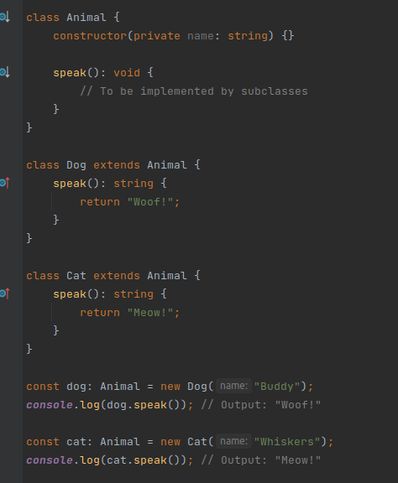
OOP
OOP revolves around objects that
encapsulate data and behavior.
Key features include classes, objects,
inheritance, and polymorphism.
OOP aims to create reusable and modular
code by organizing data and functions
into classes.
Notes:
OOP, or Object-Oriented Programming, is a way of writing code that focuses on organizing data and actions into self-contained units called objects. Objects are like containers that hold information (data) and behaviors (actions) related to a specific concept or thing. By using OOP, you can create reusable and modular code, where objects can interact with each other through defined relationships. It helps in managing complexity, improving code organization, and promoting code reusability, making it easier to build and maintain larger software projects.

Slide 9
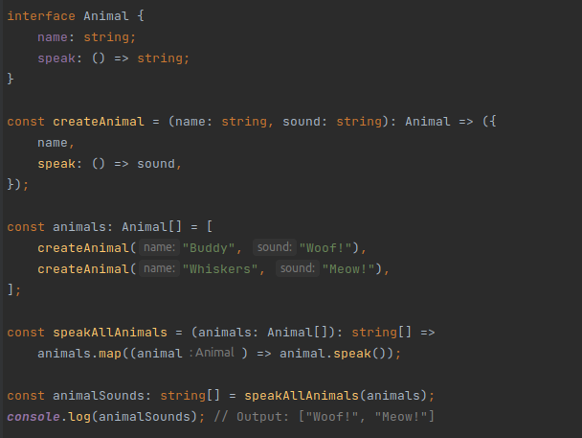
FP
FP focuses on immutability, pure
functions, and function
composition.
It treats computation as the
evaluation of mathematical
functions, avoiding shared
state and mutable data.
Notes:
Functional Programming is a programming paradigm that emphasizes writing code in a way that focuses on computations as the evaluation of mathematical functions. It treats functions as first-class citizens, meaning they can be assigned to variables, passed as arguments, and returned as results. Functional Programming avoids changing data or maintaining state, instead emphasizing immutable data and pure functions that produce consistent outputs for the same inputs. It encourages writing code that is declarative, concise, and easier to reason about. By using Functional Programming, you can achieve code that is more modular, easier to test, and less prone to bugs.

Slide 10
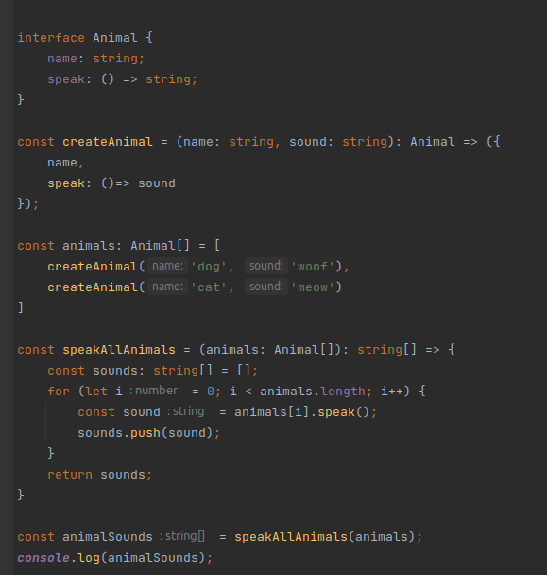
PP
PP focuses on procedures or
routines that operate on data.
It emphasizes step-by-step
instructions to solve problems,
using functions and control
structures.
Notes:
Procedural Programming is a programming paradigm that focuses on writing code in a step-by-step manner, following a set of instructions or procedures. It revolves around organizing code into procedures or functions that perform specific tasks. The flow of execution is typically linear, moving from one procedure to another. Procedural Programming relies on variables to store and modify data throughout the program. It is straightforward and easy to understand, making it suitable for smaller projects or tasks that involve a clear sequence of steps.
In summary, while both paradigms involve writing code in a procedural manner, Functional Programming places a stronger emphasis on immutability, pure functions, and mathematical principles, whereas Procedural Programming focuses on organizing code into procedures and allows for state changes through variables.

Slide 11
Core Universal Rules
No matter which Programming Language you’re using, you better use:
  Meaningful and Readable names.
  Slim functions that do what they say they do (no side effect).
  Easy to follow code flow
  etc

Slide 12
Clean Code vs Quick Code
Making the code ugly does not make it fast (preformance prespective speaking).
Making the code clean does not make it slow (or fast).
Making the code ugly does make the maintainer's work slower.
Clean code usually means the code was made by someone who cares.
One who cares to make his code clean, usually cares to make it efficient.
Hardware becomes cheaper with time.
Programmers don't get cheaper over time.
CPU time is cheaper than programmer's time.
Some performance problems can be solved by throwing money at them.
Very few code maintainability problems can be solved by throwing money at them.

Slide 13
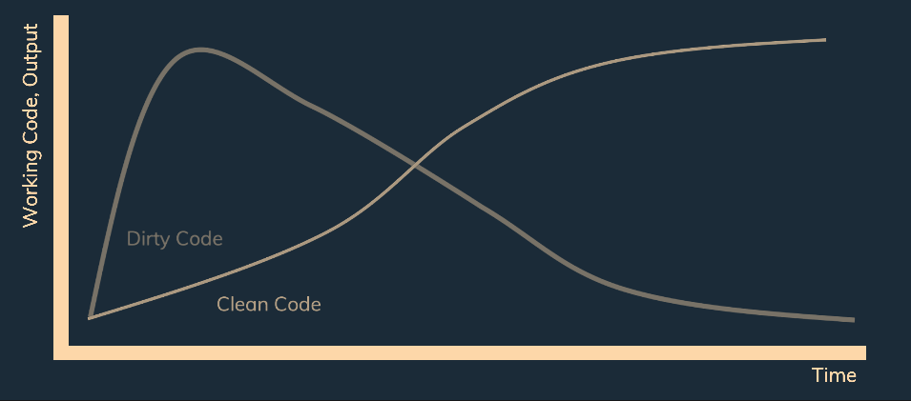
Summerized Diagram

Slide 14
Naming
Why names are important?
Naming Casing Conventions
Naming "Startegies"

Slide 15

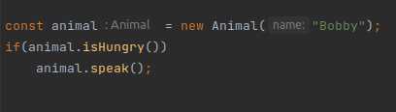
Meaningful
Explain this code ---->
How about this ---->
Naming "Strategy"

Slide 16
Why names are important
const animal = new Animal()
db.insert(animal)
logger.info(message)
To understand these codes’ examples, we don’t need
to go through the full implementation of it.
Well named varliables, functions or entities allow the reader
to understand the code in a blink of an eye

Slide 17
Naming Casing Conventions
snake_case
camelCase
PascalCase
kebab-case

Slide 18
Naming "Strategies"
Constants & Varliables
  Nouns (user, animal)
  Short expression with adjactives (isLoggedIn, isNameValid)
    An object, number or string – describe the value
    A boolean – An answer for yes/no question – isActive, isLoggedIn
Generally speaking – we want to provide more details without being redundant:
  user ----> authenticatedUser
  name ----> firstName
  IsLoggedIn -----> isUserLoggedIn (?)

Slide 19
Variables Examples
We’ll discuss Bad names, Okay names, and Good names:
  A user object
  User input validation result (boolean)

Slide 20
Functions & Methods – Describe the operation
  Commands, verbs ( sendEmail(title, content, address) )
  Short phrase with adjectives ( getCalculatedArea(width, height) )
  Boolean value calculated gets special treats – usually named as an answer for true/false question:
  user.isLoggedIn( ), user.isEmailVerified( )
Again - Informative(+) redundancy(-)
  getUser(...) ----> getUserByEmail(...)
  response.send( ) ----> response.send( )

Slide 21
Functions’ Names Examples
We’ll discuss Bad names, Okay names, and Good names:
  Save new user to a database
  Validate the user input

Slide 22
Classes – Describe the object
  Nouns ( User, Animal )
  Short expressions ( AlertMessage )
Examples
  A user
  A database

Slide 23
Follow \ UnFollow
 | Avoid | Instead Do
Disinformation | animalList = {a1: ..., a2: ...} | animalsIndex: {a1: ..., a2:...}
 | allUsers = users.filter( ) | premiumUsers = users.filter( )
Unclear statements | insert(data) | insert(user)
 | timeSinceAlert = ... | TimeSinceAlertInSec =
Slang | IsInputFarOut = ... | IsInputValid = ...
Distinctive Names | calculateArea(x, y) | calculateTriangleArea(height, base)
 | calculateArea(p, r) | calculateCircleArea(centerPoint, radius)

Slide 24
Consistencty
getSomething <------> fetchSomething
saveSomeThing <------> insertSomething
deleteSomeThing <------> removeSomeThing
Stick to one prefix through the whole project

Slide 25
Comments
Discussion
  Are comments a good thing?
  When should we use them?

Slide 26
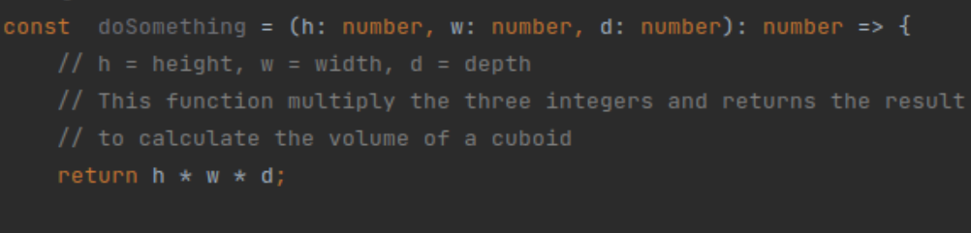
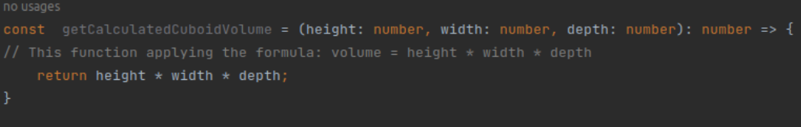
Bad Comments
Reduntant Information
  A comment should not explain what the code is doing (for this we have the previous remarks of naming conventions, code structure, etc).
  A comment should explain why he is doing so (when it’s not obvious).

Slide 27
Bad Comments
Dividiers
////////////////////////////SOME TITLE/////////////////////////////////////////
  It’s probably a sign that the file should be seperated into differnet files.
Commented out code
  When we will do some change we will probaby first keep the previous code commented out as refference, however, when the new version is stable it is better if we would delete the old code, which we could always retrieve (assuming we are using some versioning control tools)

Slide 28
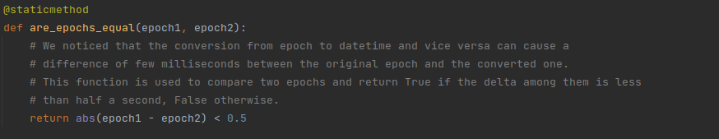
Exeptional Cases
Legal Information (copy rights)
TODOs
Explaination which can’t be replaced by good naming (Regex)
Explain why you are doing something (when it’s not obvious)

Slide 29
Avoid Comments

Slide 30
Code Formatting
Vertical Formatting
  Space between lines
  Grouping of codes
Horizontal Formatting
  Line width
  Space between Code
  Indentation

Slide 31
Propper Formatting
Formatting is important and different languages
apply different formatting rules
For specific details search online for
"[LANGUAGE] style guide"

Slide 32
Vertical Formatting
Top to bottom principle – Code should be written like an assay
without many "jumps"
One Entity in a file principle – Will help to avoid a file which is "too big"
Seperating different consepts in a file with an empty line
  Import
  Entity declaritions
    Constructor
    Static functions
    private\public functions
    Setters
    Getters
    Overrides
    Stick related functions together
  Entity initialize
  Export

Slide 33
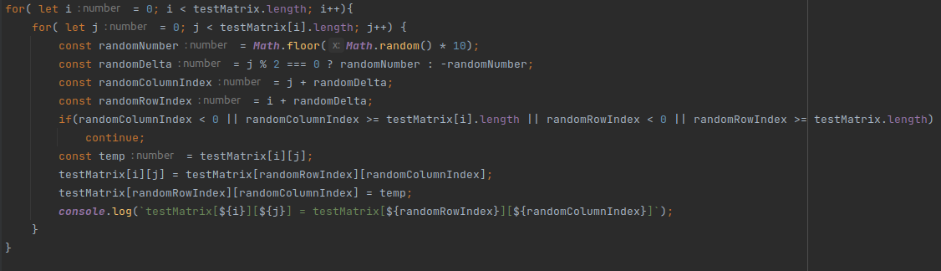
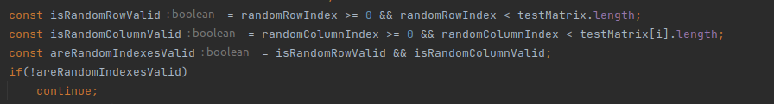
Horizontal Formatting
Identation
Break long statements into multiple shorter ones

Slide 34
Functions
Arguments
Responsibility and length
We will mention Functions but methods follow same principle​s, hence they are simple functions of an object.

Slide 35
Is it a good function?
To answer this question we should answer the following questions first:
  Is the function doing what it says it’s doing? (0 side effects)
  Is calling the function readable? (number of arguments)
  Is the implementation of the function is readable?
  (length, abstraction level)

Slide 36
Number of Parametres
We should aim to minimize the number of parameters
  user.save( )
  logger.info(message)
  const point = new Point(0, 1)
  calc(5, 6, "add")

Slide 37
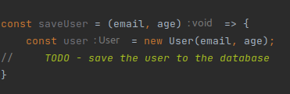

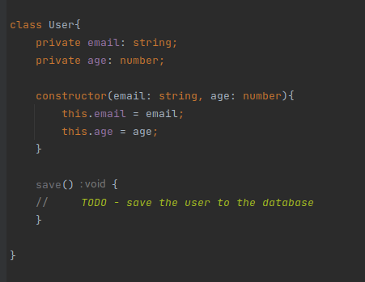
Example

Slide 38
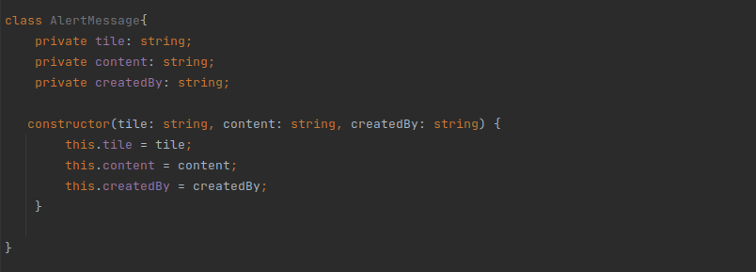
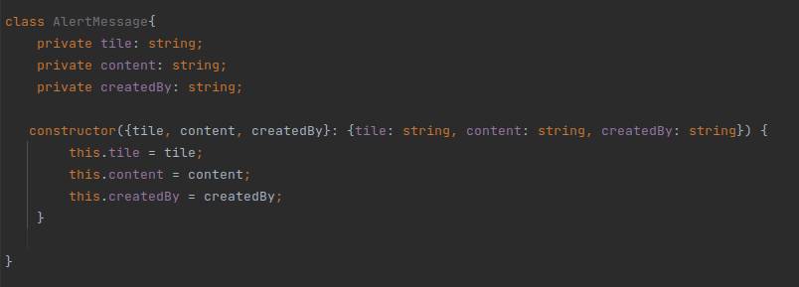
Dealing with multi Params
Is there an option to convert multiple arguments structure into a single one?

Slide 39
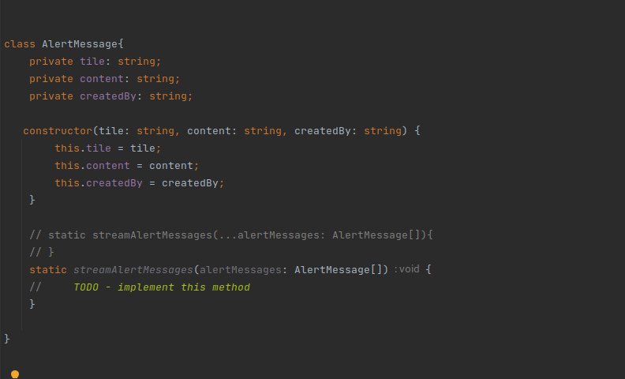
Multi Arguments Example
Some times it can be Ok.

Slide 40

Output Parameters
Public functions (besides getters, and other examples) should avoid output parameters (if possible)
The output Parameters should be as expected by the name of the function.

Slide 41
Functions Length
Functions’ length should be SMALL
It is easy to do so if each function responsible on one thing.
One thing = one operation
Single function should include similar levels of abstractions

Slide 42
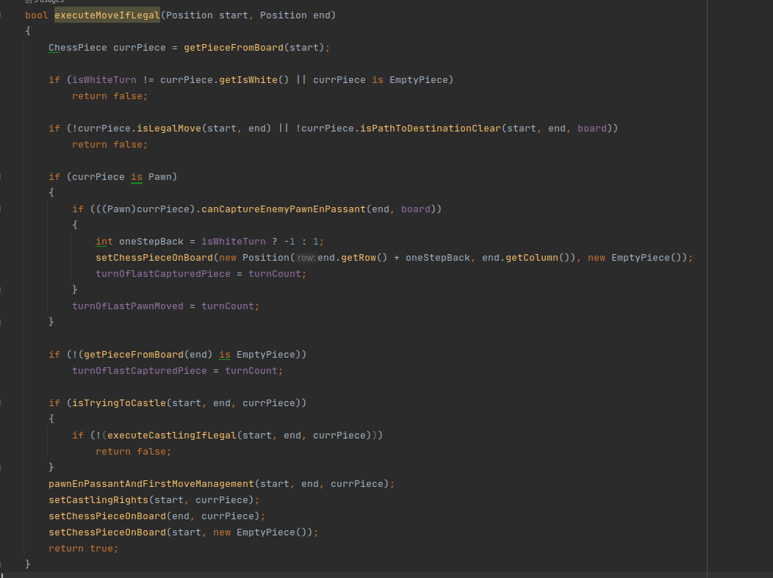
Levels of Abstractions

Slide 43
Beeing DRY
DRY – "Don’t Repeat Yourself"
Short function might increase reusability of the code we write.
Follow this principle would make code maintainbility much easier
Signs you are not writing DRY code:
  Applying the same change in multiple places in the code base
  Copying & pasting code

Slide 44
Side Effects
Discussion – what is a Side Effect ?
Is it a good/bad thing?
Ways to deal with side effects:
  Move the side effect into another function to deal this responsibilty
  Choose proper name to the function it is in

Slide 45
Flow Structures
Nested Flow Structures
Error handling

Slide 46
Avoid Deeply Nesting
Instead of deeply nested conditions it’s ususally better to use
  Fail Fast and use Guards:
    if(isSomeConditionPass){
    // apply a function
    return
    } // convert to:
    If(!isSomeConditionPass){
    return
    }
    // apply a function
  Apply handle functions:
    if(isSomeConditionPass){
    // do a lot of stuff
    } // convert to:
    if(isSomeConditionPass){
    // apply a function
    }

Slide 47
Use Error Handling
It is possible to use error handling to avoid side effects in a function
doSomeThing(param){
if(!isParamValid(param){
logger.error("Invalid param");
return;
}
proccesParam(param);
} // converted to:
doSomeThing(param){
if(!isParamValid(param)
throw new Error("Invalid param");
proccesParam(param);
}

Slide 48
Factory Functions
Another way to increase code readability and control the flow structure is to use Factory Functions:
A factory function can be defined as a function that creates an object and returns it. It is similar to classes’ constructer only without the need to declare a class.

Slide 49
Classes & Objects
OOP
  Law of Demeter
  SOLID
Polymorphism
Notes:
Imagine you have different animals: a cat, a dog, and a bird. Each animal has its own unique behavior. Now, let's say you want to teach them all to make a sound. The sound might be different for each animal, but you want a single method to handle making the sound for all of them.
In programming, polymorphism allows you to achieve this. You can define a common method called "makeSound" that all animals can use, but each animal can implement it in its own way. The "makeSound" method acts differently depending on the type of animal that calls it. This is polymorphism in action.
To illustrate this further, let's say you have a program with an array that holds different animal objects. You can loop through the array and call the "makeSound" method for each animal without knowing their specific types. The correct sound will be made by each animal, thanks to polymorphism.
Polymorphism helps make your code more flexible, reusable, and easier to maintain. It allows you to work with different objects in a unified way, even if they have different behaviors or properties.
So, in a nutshell, polymorphism is like having different objects that can share a common method, but each object can perform that method in its own unique way.

Slide 50
Classes & Objects
Note unOfficial difference between an Object and Data Container:
  Data Container:
    Public properties
    No API
    Store data
  Object:
    Private properties
    Public API
    Add absraction

Slide 51
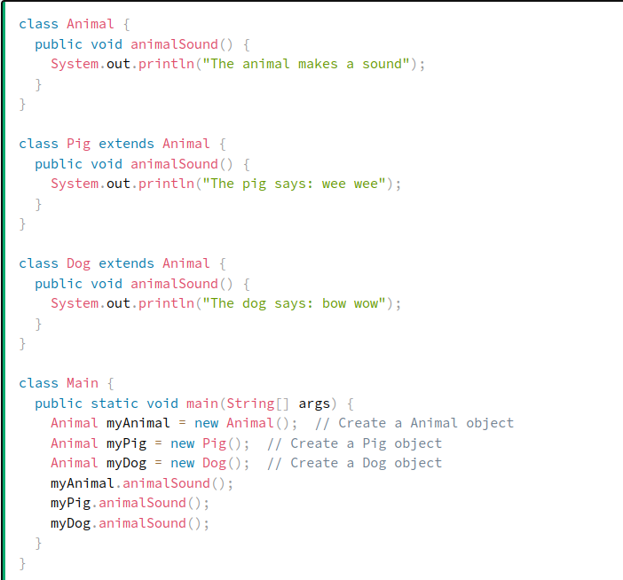
Polymorphism
Polymorphism means "many
forms", and it occurs when
we have many classes that are
related to each other by
inheritance.
Polymorphism can be helpful
to write clean code

Slide 52
Cohesion
How can we know if the class we wrote has too many responsibility?
  How much out of the class’ properties is being used in its methods?
    Maximum Cohesion <----> All methods use all properties
    No Cohesion <----> All methods use none of the properties
  We should keep the cohesion to be on a high level
  Once the cohesion level is decreased it is a sign we might need to devide the class

Slide 53
Law Of Demeter
The Law of Demeter, simply stated, says that an object should not “reach through” its collaborators to access their collaborators' data, methods, or collaborators.
this.logger.printer.info(message) - bad
this.logger.info(message) - good

Slide 54
SOLID Principles
S – Single responsibility (SRP)
O – Open/Closed (OCP)
L – Liskov Subsitution (LP) // less important
I – Interface Segregation (ISP) // less important
D – Dependency Inversion (DIP) // less important
Notes:
Single Responsibility Principle (SRP):
The SRP states that a class should have only one reason to change. It means that a class should have a single responsibility or purpose, and it should be focused on fulfilling that responsibility. By adhering to SRP, classes become more maintainable, reusable, and easier to understand.
Open/Closed Principle (OCP):
The OCP states that software entities (classes, modules, functions) should be open for extension but closed for modification. It means that the behavior of a component can be extended without modifying its source code. This principle promotes code stability, reusability, and the ability to introduce new functionality without impacting existing code.
Liskov Substitution Principle (LSP):
The LSP states that objects of a superclass should be replaceable with objects of its subclasses without affecting the correctness of the program. In other words, derived classes should be substitutable for their base classes without introducing errors or violating expected behaviors. Adhering to LSP ensures the correct behavior of polymorphic objects and promotes design consistency.
Interface Segregation Principle (ISP):
The ISP states that clients should not be forced to depend on interfaces they do not use. It promotes the idea of having fine-grained, specific interfaces rather than large, monolithic ones. By separating interfaces into smaller, more focused units, we avoid the problem of clients being forced to implement methods they don't need, leading to cleaner code and better maintainability.
Dependency Inversion Principle (DIP):
The DIP states that high-level modules should not depend on low-level modules. Both should depend on abstractions. This principle promotes loose coupling and decoupling between modules by relying on abstractions instead of concrete implementations. By following DIP, we can easily replace dependencies, promote testability, and achieve a more flexible and modular design.

